Slide 1
Agentic AI Hackathon: Building Intelligent Agents with IBM Granite and LangFlow
AI-Based Chronic Disease Monitoring Assistant

Slide 2

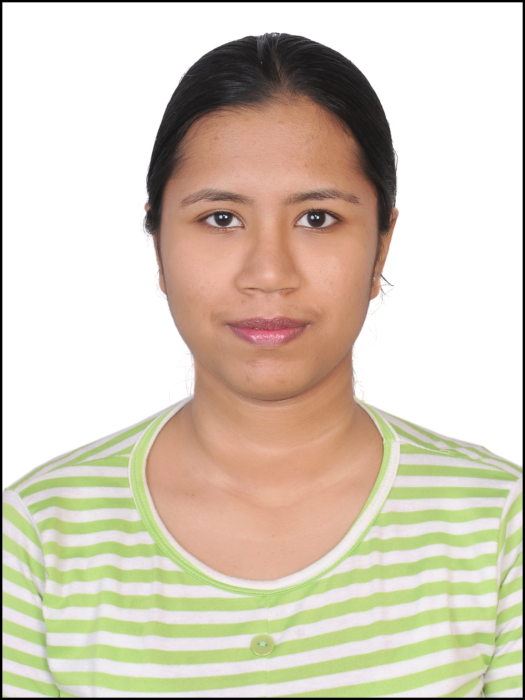

Name of the team: MEDORA
Details of Team members
TEAM MEMBER NAME | Recent Passport Photo | Email ID | Phone number [WhatsApp]
Vaidehi V Arundekar |  | arundekarvaidehi@gmail.com | 7619410648
Vinutha B R |  | vinuthabr2020@gmail.com | 9380996821
Sneha K S |  | aradhanagowda@gmail.com | 6362848382

Slide 3
Problem statement
AI-Based Chronic Disease Monitoring Assistant
The Challenge
Information overload – Patients with chronic diseases generate large volumes of daily health data from self-monitoring devices and logs, making continuous manual analysis difficult for healthcare providers.
Personalization gaps – Existing monitoring systems often provide generic insights and recommendations, failing to adapt to individual patient history, condition severity, and lifestyle patterns.
Unreliable sources – Patients frequently rely on unverified online health information, leading to confusion, misinformation, and poor self-management decisions
.
Dynamic conditions – Chronic health conditions such as diabetes, hypertension, and asthma involve continuously changing health parameters that require real-time, adaptive monitoring.

Slide 4
Proposed solution
The AI-Based Chronic Disease Monitoring Assistant is an agent-based, intelligent assistive system built on IBM Cloud using LangFlow and the IBM Granite Model. The system continuously analyzes patient-generated health data to support proactive and personalized chronic disease management.
The solution employs multiple specialized AI agents:
Health Data Analysis Agent that ingests daily health logs such as blood glucose levels, blood pressure readings, peak flow values, and medication adherence data, organizing them into meaningful short-term and long-term health trends.
Risk Trend Detection Agent that evaluates these trends against clinical thresholds and historical patient data to identify abnormal patterns and early signs of potential health deterioration.
Alert & Lifestyle Recommendation Agent that generates early warning alerts and provides personalized lifestyle and care recommendations based on trusted clinical guidelines, ensuring the system remains assistive and non-diagnostic.
Using Retrieval-Augmented Generation (RAG), the system retrieves knowledge from chronic disease management guidelines and trusted healthcare references, ensuring accurate, explainable, and reliable outputs.
This intelligent assistant enables early risk awareness, timely intervention, and improved long-term health outcomes for patients with chronic conditions.

Slide 5
Need of project
Chronic diseases such as diabetes, hypertension, and asthma require continuous monitoring to prevent complications, but healthcare professionals cannot track patient health data in real time.
The increasing use of self-monitoring devices generates large volumes of health data, which remains underutilized due to lack of intelligent analysis.
Early warning signs of health deterioration are often missed, leading to delayed medical intervention and increased healthcare risks.
Patients lack access to reliable, personalized, and clinically aligned guidance for daily health management.
There is a strong need for an AI-based, agent-driven assistive system that can continuously analyze health data, detect risk trends early, and provide timely alerts and lifestyle recommendations.

Slide 6
End user of project
Patients with Chronic Diseases:
Individuals managing conditions such as diabetes, hypertension, and asthma who require continuous monitoring and timely guidance.
Healthcare Professionals:
Doctors, nurses, and care providers who need summarized health trends and early risk alerts to support better clinical decision-making
.
Caregivers & Family Members:
Family members responsible for patient care who benefit from alerts and health status awareness.
Healthcare Organizations:
Hospitals and clinics seeking scalable, intelligent solutions to improve chronic disease management and reduce care burden.

Slide 7
Technology Used
Data Langflow platform
Langflow component name – Agent , Chat input , Chat output
IBM Granite model - for eg – ibm-granite-3-2-8b
IBM Cloud
Astra DB
Prompt Template
RAG if used
IBM Watsonx.ai
Watsonx

Slide 8
Novelty and Uniqueness
First agent-based chronic disease monitoring platform combining continuous health data analysis, GenAI, and clinical guideline retrieval for proactive care.
Uses multi-agent orchestration via LangFlow, enabling modular, scalable, and explainable health trend analysis rather than a single monolithic model.
Integrates IBM Granite Model with RAG to deliver clinically aligned, trustworthy, and non-diagnostic recommendations from verified healthcare sources.
Focuses on trend-based risk detection instead of isolated readings, enabling early warning of chronic condition deterioration.
Granite-guarded outputs ensure responsible, bias-aware, and assistive healthcare guidance compliant with best-practice standards.

Slide 9
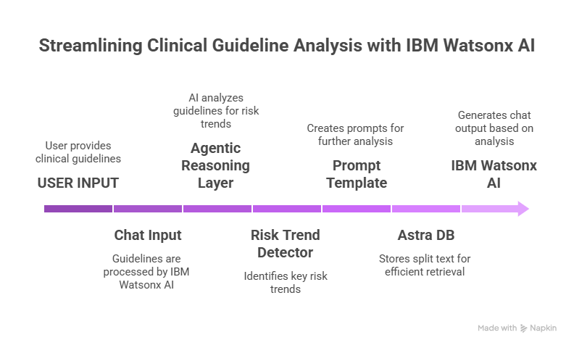
Technical flow diagram - Architecture blueprint

Slide 10
Langflow component Used
Explain the use of each langflow component used into you project
Chat Input –
IBM watsonx AI Agent
File component
Chat output
Prompt Template
Astra DB
Split Template
Test Input

Slide 11
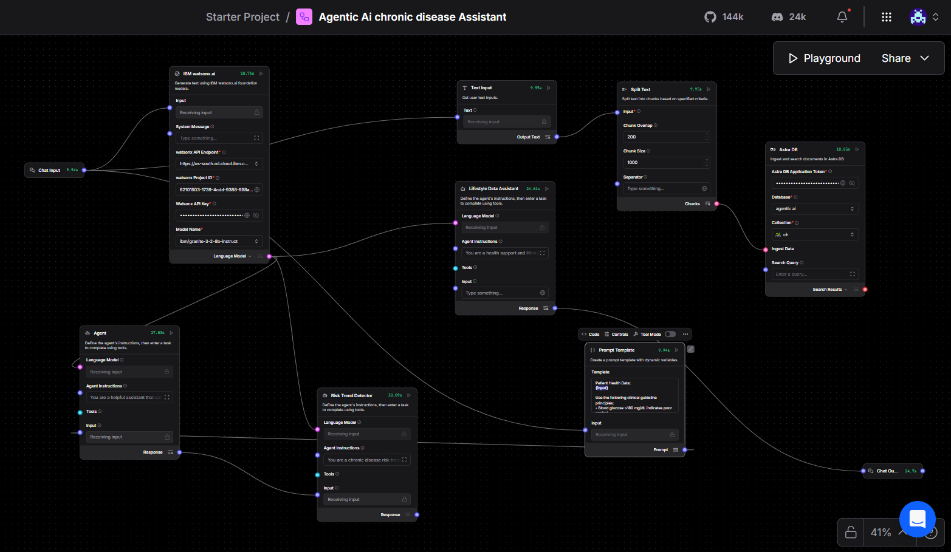
Input Screenshot 1

Slide 12

Input Screenshot 2

Slide 13
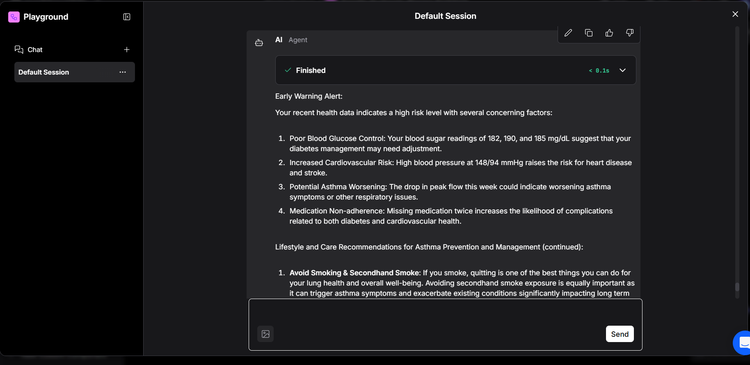
Output Screenshot 1

Slide 14
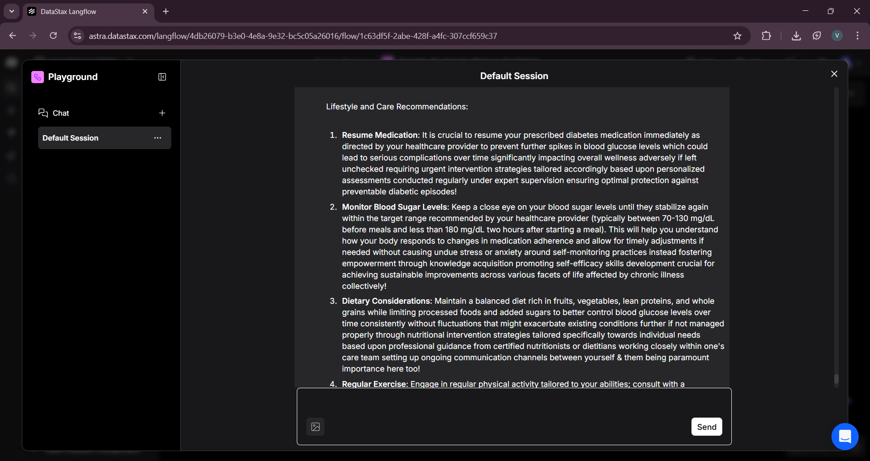
Input Screenshot 2

Slide 15
Future Scope
• Integration with wearable and IoT health devices for real-time and automated data collection.
• Expansion to support additional chronic conditions such as cardiovascular diseases, COPD, and arthritis.
• Development of doctor and caregiver dashboards for advanced monitoring, analytics, and intervention planning.
• Enhanced predictive risk modeling using long-term historical data and advanced AI techniques.
• Multi-language and voice-based support to improve accessibility and inclusivity.
• Integration with Electronic Health Record (EHR) systems for seamless clinical workflows.
·
·
·

Slide 16
Git Hub Link
Git Hub repository link: git@github.com:vaidehi2965/-AI-Based-Chronic-Disease-Monitoring-Assistant.git
·
·
·

Slide 17
References
cloud.ibm.com/login
"Cloud Infrastructure Solutions". IBM.com. IBM. Retrieved 21 August 2025. The IBM Cloud approach to IaaS lets you scale… around the world in more than 60 data centers… 60 data centers across 19 countries.
"Watson, A System Designed for Answers: The Future of Workload Optimized Systems Design". IBM Systems and Technology. February 2011. p. 3. Archived from the original on March 4, 2016. Retrieved September 9, 2015
·
·
·

Slide 18


